Slide 1
Self-Playing Guitar
CS Group 22 / ECE Group 30

Slide 2


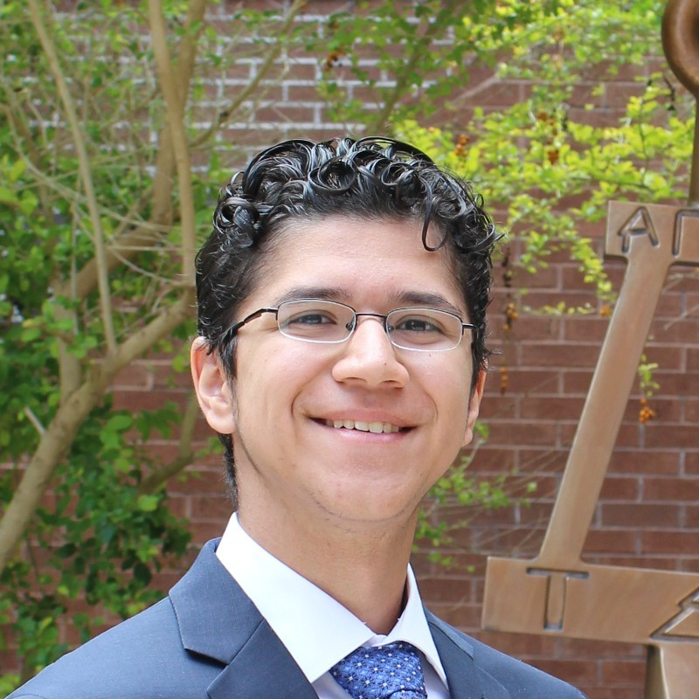

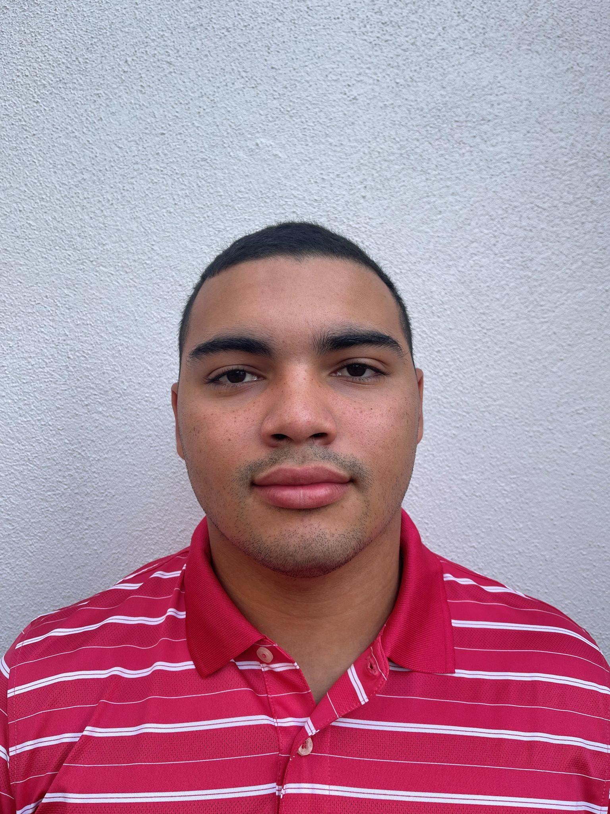
Team Member Introductions
Pedro Contipelli (CS) - Music Processing & Motor Output Algorithm
Blake Cannoe (CpE) - Microprocessor code & Motor Control
Ethan Partidas (CpE) - Microprocessor code & Mechanical Design
Kyle Walker (EE) - PCB Circuit Design & Voltage Regulator Design
Jon Catala (EE) - PCB Circuit Design & Microprocessor Integration

Slide 3
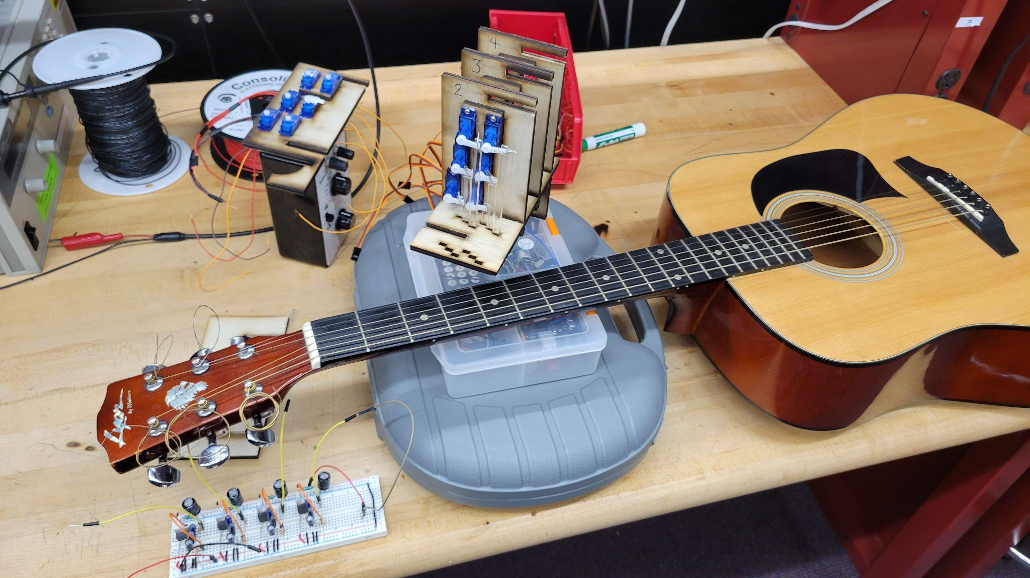
Project Description
Fully autonomous robotic guitar that can use its motors to play any song input to the system via MIDI file (both strumming and fretting)

Slide 4
Project Goals
Foster interest in STEM fields for children and make the field more accessible by using a universal language anyone can understand
Bridging the gap between engineering and art
Learn from each other, while working as a team to create something none of us could have done alone
Produce an entertaining display and listen to some good tunes!

Slide 5
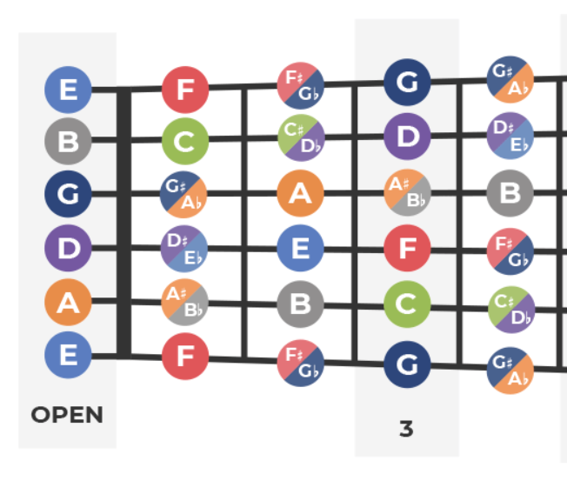
Minimum Viable Product Requirements
Portable / Able to be Battery Powered
Ability to process virtually any MIDI file
Access full range of 4 frets (~2.5 octaves E2 - G#4)
Must be able to independently fret and strum multiple strings at once
Play well enough for song to be recognizable

Slide 6
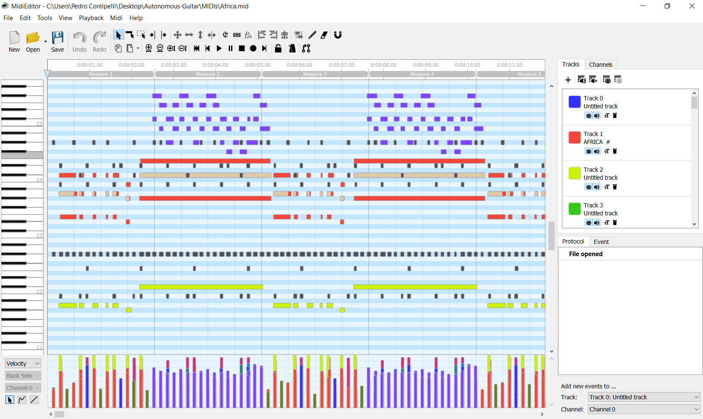
Detailed Design: MIDI Preprocessing (Input)

Slide 7
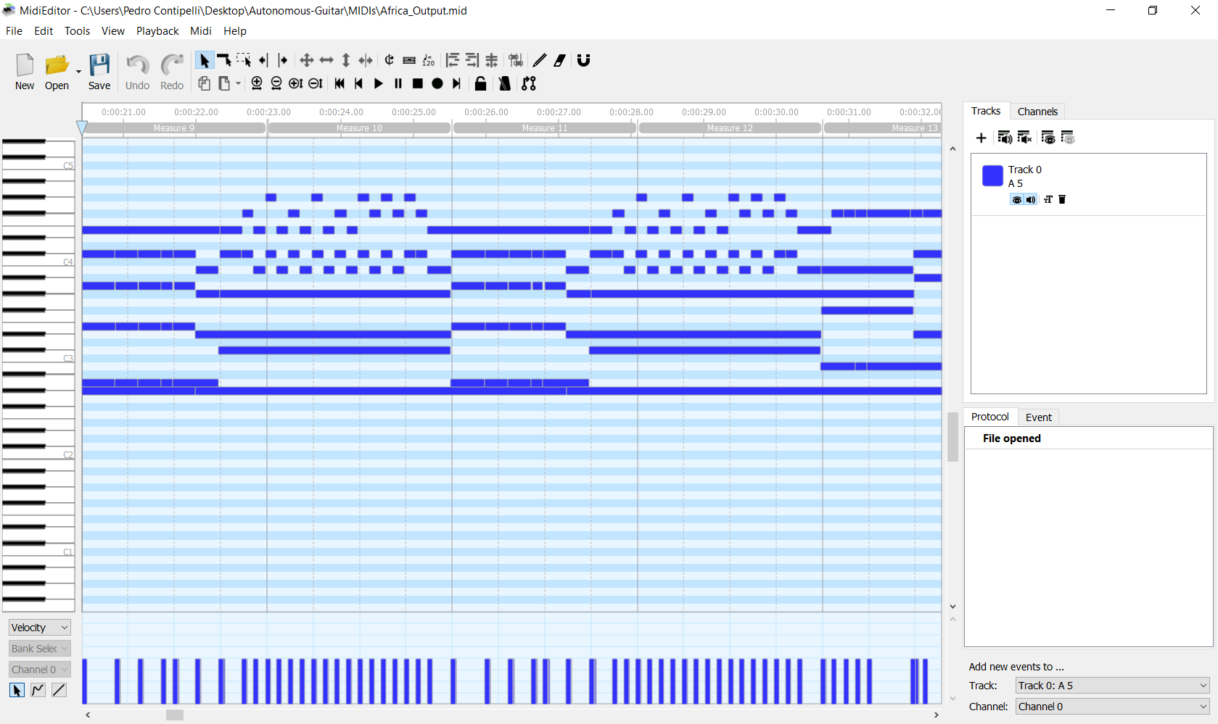
Detailed Design: MIDI Preprocessing (Output)

Slide 8


Detailed Design: MIDI Preprocessing Algorithm
Input MIDI file
Mute/remove unplayable tracks (drums, synth, etc) and combine all into single track
Range Shift to maximize playable notes
Loop through track, ignoring unplayable instructions
Compress outlier notes into playable range
Force end overlapping notes occurring on same string
2nd pass loop through track
Remove notes that happen in succession too quickly
(to ensure enough spacing between notes that is physically possible)
Output new MIDI file

Slide 9


Microcontroller Motor Output Code
Code written in MicroPython using UMidiParser library
Must be able to play at least 6 independent notes simultaneously (1 per string), thus 12 servo outputs (6 for strumming & 6 for fretting)
Needs the servo on the neck to press down before the string is plucked

Slide 10
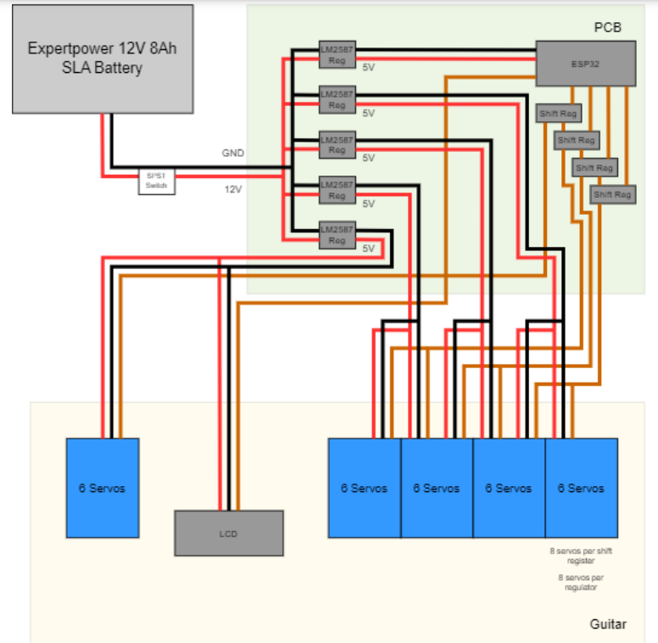
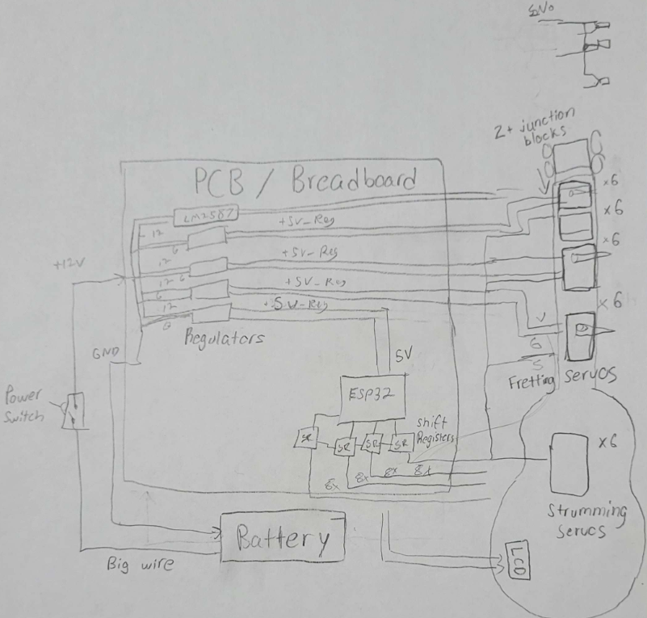
Hardware Design Overview
Initial draft
Final draft

Slide 11
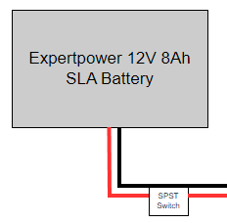
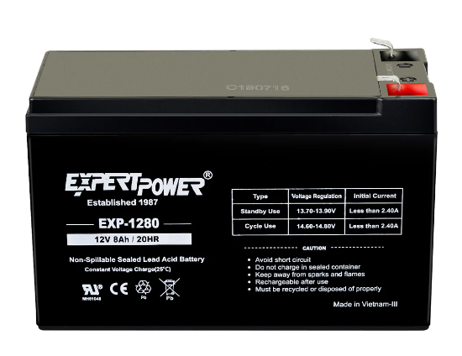
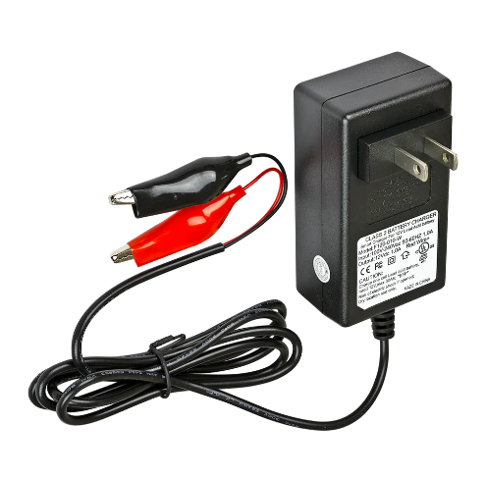
Detailed Design: Power Supply
12V Output Voltage
8A Output Current over the span of 1Hr
Rechargeable
Worst-Case Current Load of 8.6A
Estimated 2.5A

Slide 12
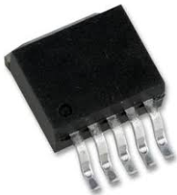
Detailed Design: Regulators
5 LM2576 Switching Regulators
LM2576ADJ features adjustable output voltage
Both Through-Hole and SMT packages
Distribution of heat
Allows for convenient utilization of TI resources

Slide 13
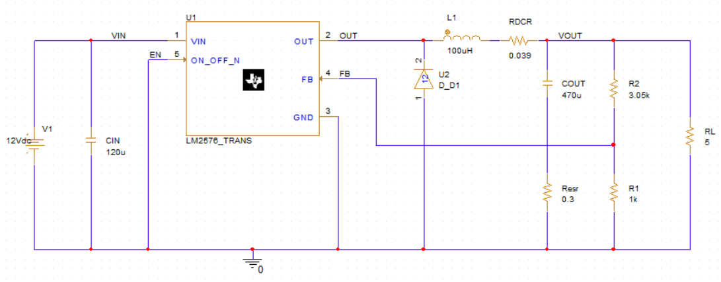
Detailed Design: Regulator Schematic

Slide 14
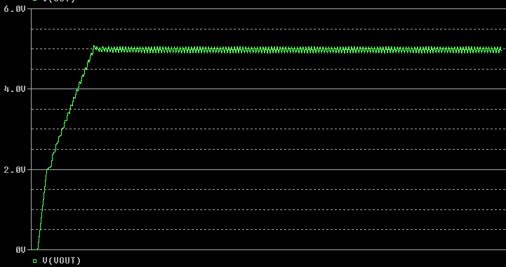
Detailed Design: Regulator Simulation

Slide 15
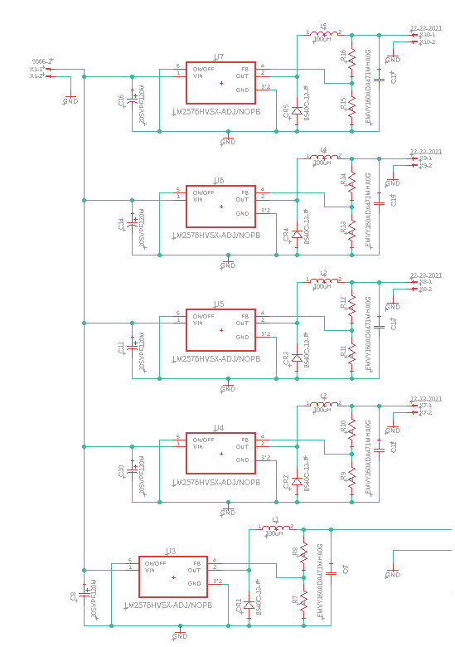
Detailed Design: Power Supply Schematic

Slide 16
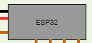
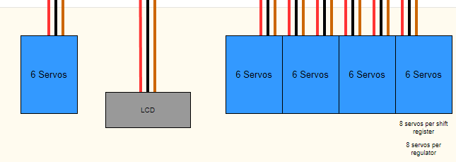
Detailed Design: Power Distribution
5 servo assemblies, 6 servos each
24 servos for Fretting Assembly
6 servos for Strumming Assembly
Regulator Load Isolation

Slide 17
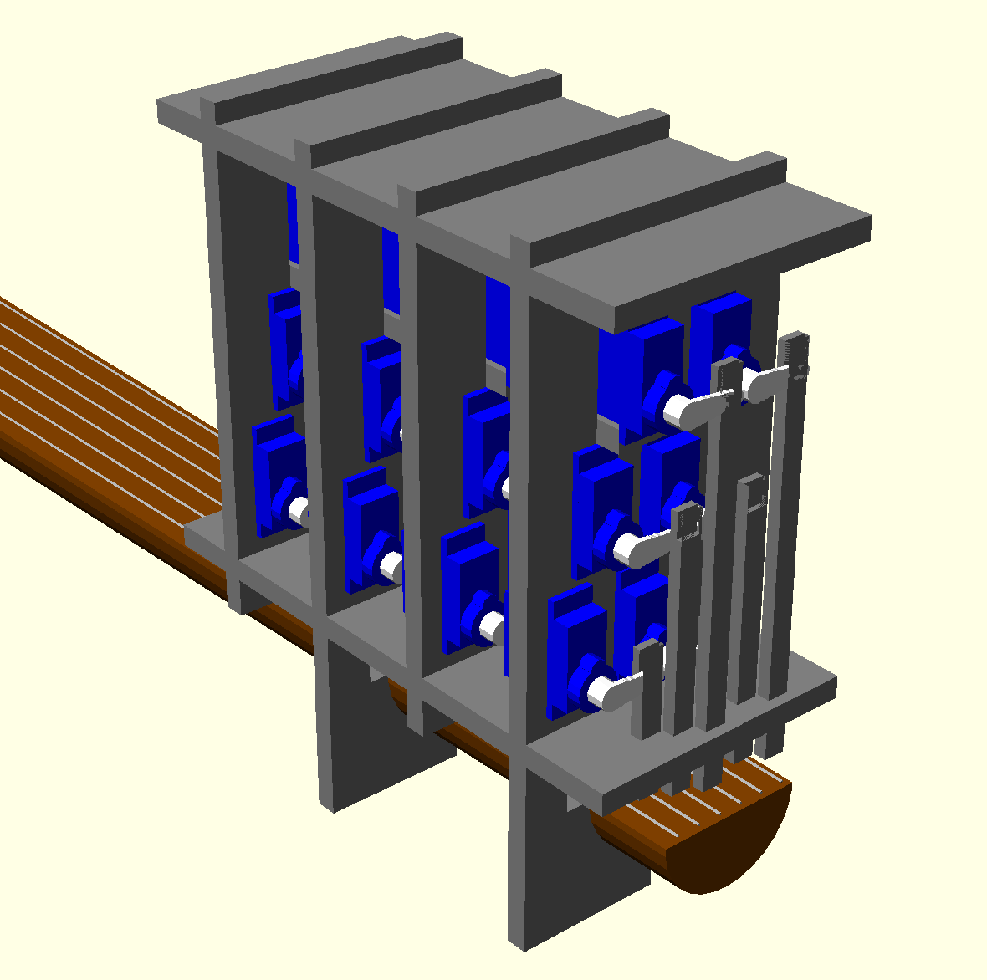
Mechanical Design: Modeling Software
Fretting Mechanism OpenSCAD Model
Why OpenSCAD?
Code-based modeling: Low learning curve for CpE major.
Support for 3D-printing and laser cutting.

Slide 18
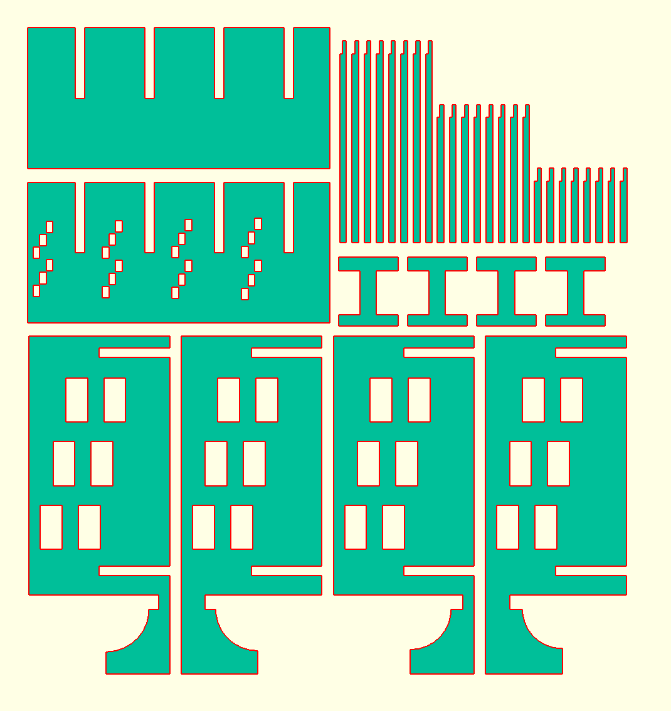
Mechanical Design: Fabrication Materials
Material | Cost | Yield
3D-printed plastic | >$100 | 1 prototype
Plywood | $25 | 8 prototypes
Original plan was 3D printing, but switched to plywood due to cost. Model had to be adjusted to match the plywood’s ¼ inch thickness.

Slide 19
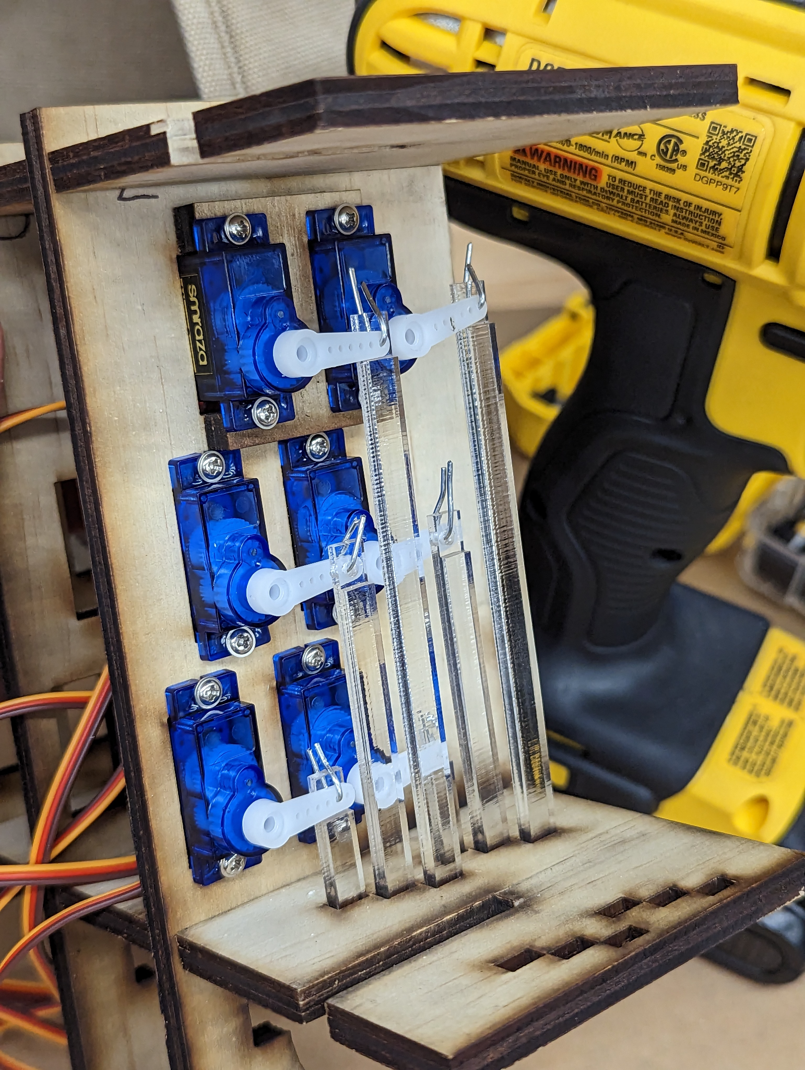
Mechanical Design: Unforeseen Fragility
Problem: Wooden arms are too fragile, split apart easily.
Solution: cut only the arms out of acrylic, use lower cost plywood for everything else. Acrylic cost an additional $25. Still cheaper than 3D printing.

Slide 20
Mechanical Design: What’s Left to be Done
Assemble and test fretting mechanism.
Design strumming mechanism
May be able to use 3D printing due to smaller size.

Slide 21
Detailed Design: Dev Board components
Power Supply
ESP 32
Micro USB
USB to UART connection
Switch Buttons
Pin Connectors

Slide 22
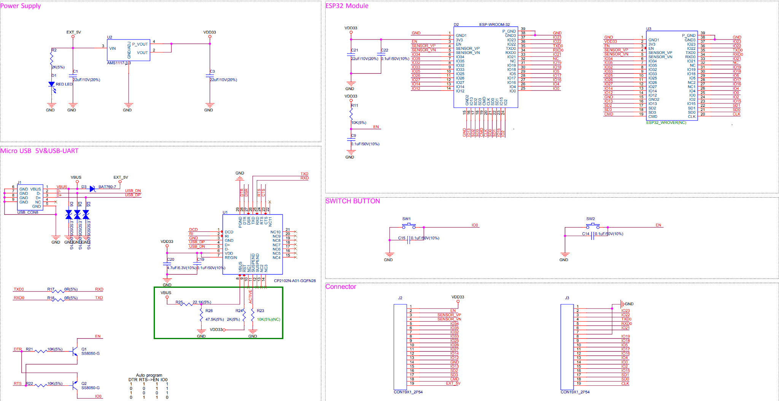
Detailed Design: Dev Board deconstruction

Slide 23
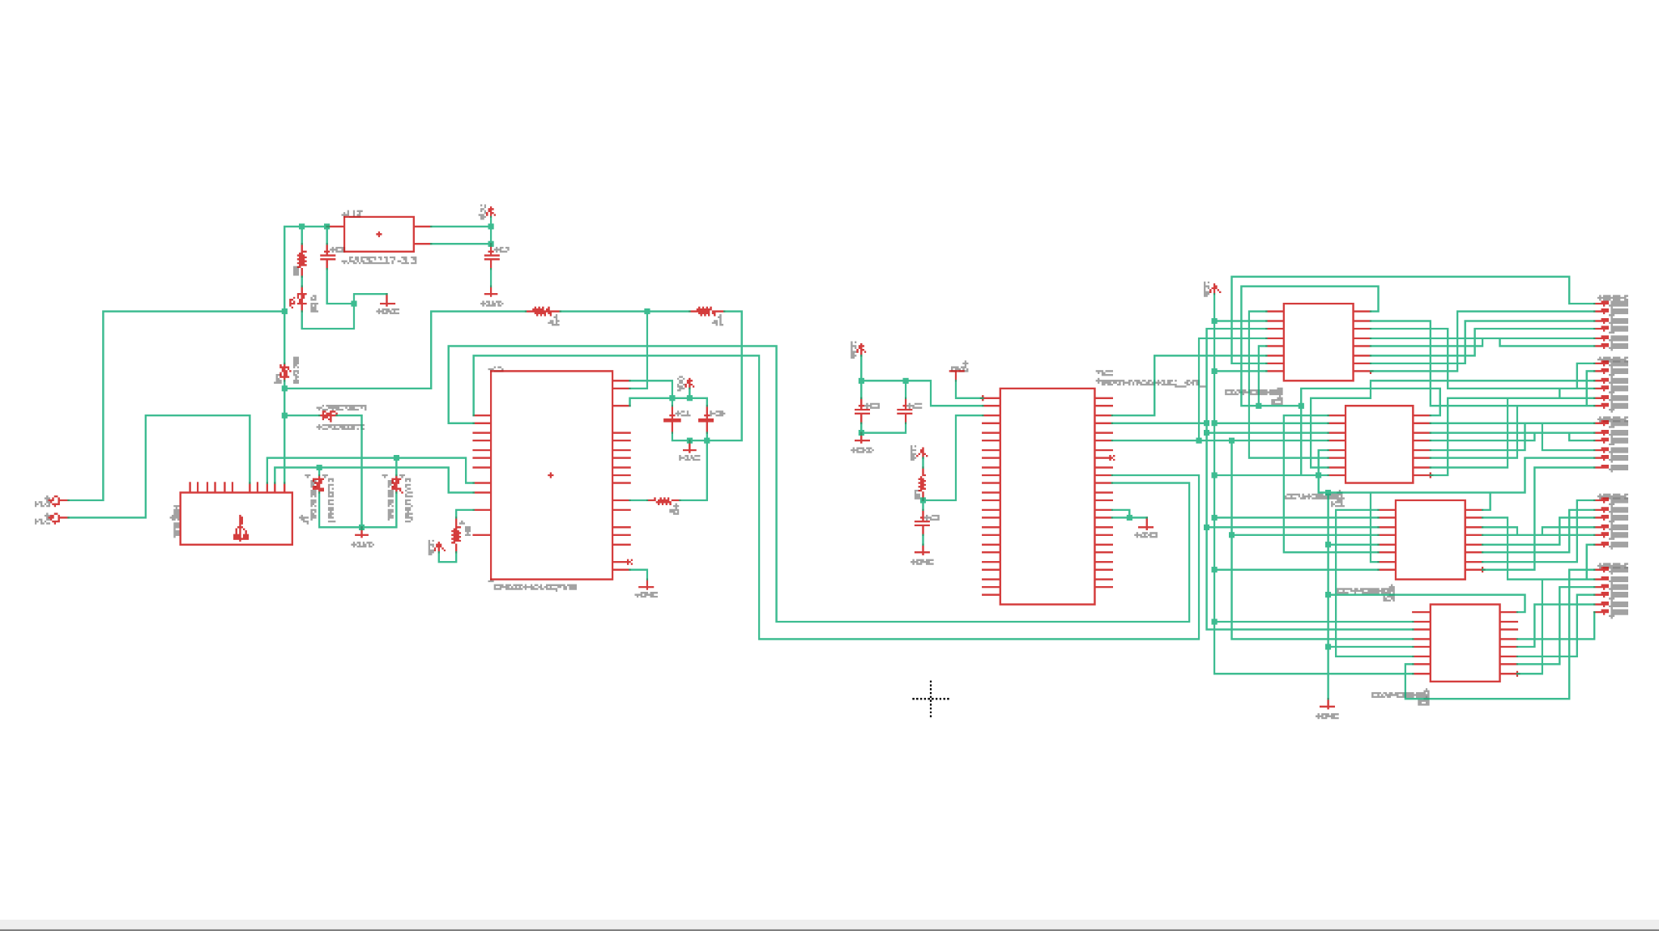
Detailed Design: DEV board schematic

Slide 24
Detailed Design: MCU Comparison
MCU | Cost | Speed | Pins | USB | Bluetooth
Arduino Due | $46 | 84 MHz | 54 | No | No
Asus Tinker Board | $75 | 4 x 1.8 GHz | 28 | Yes | Yes
ESP32 | $15 | 160 MHz | 34 | No | Yes
Libre Computer Board | $45 | 4 x 1.5 GHz | 35 | Yes | No
MSP430FR6989 | $20 | 16 MHz | 48-83 | No | No
Onion Omega 2 | $53 | 4 x 2.0 GHz 4 x 1.6 GHz | 26 | Yes | No
Odroid XU4 | $29 | 580 MHz | 18 | No | Yes
Raspberry Pi 3 Model B | $156 | 4 x 1.2 GHz | 26 | Yes | Yes

Slide 25
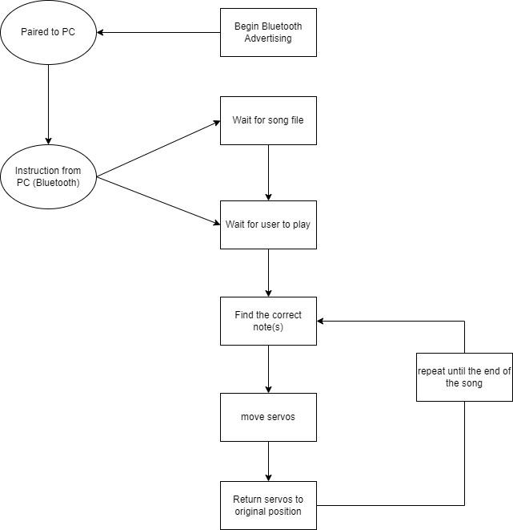
Microcontroller Operation Code
Basic operation of Microcontroller

Slide 26
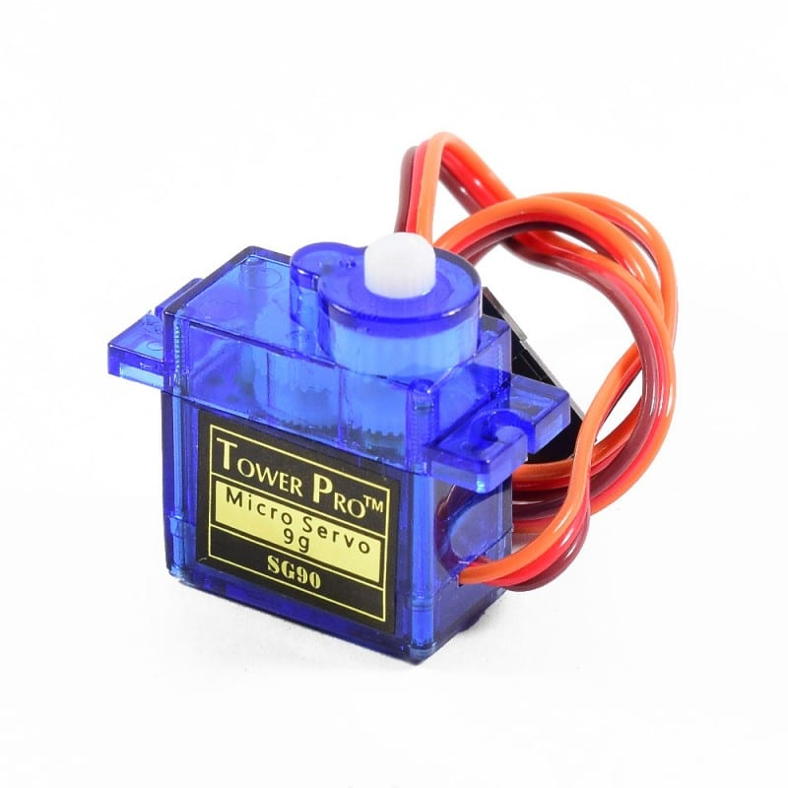
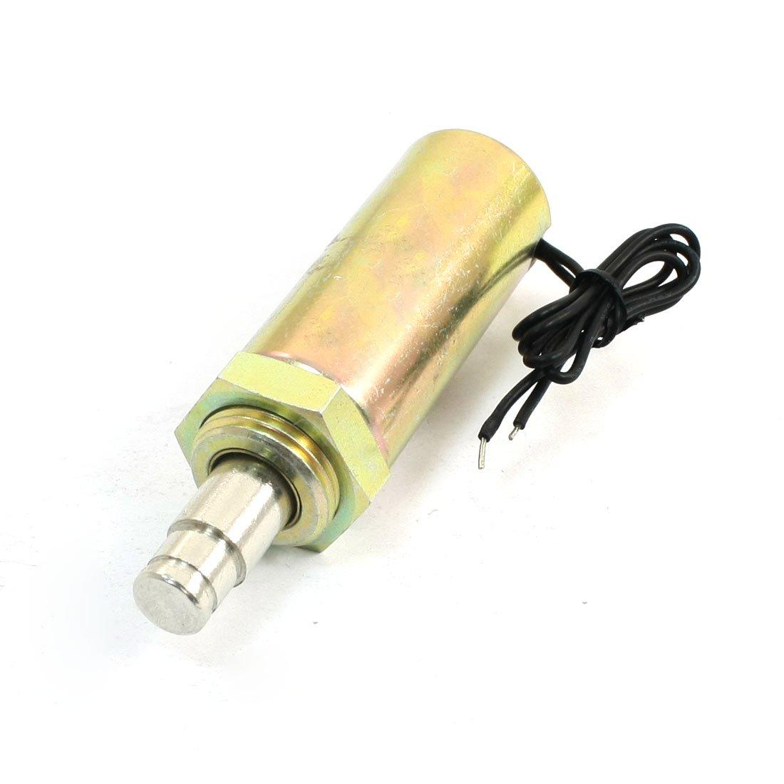
Servos Vs Solenoids
Ultimately we went with servos due to being cost efficient and having a lower voltage requirement.
Servo | Solenoid
< $2 per servo | > $9 per solenoid
Requires 4-6V | Requires 12V
Has to be adapted for linear actuation | Already is a linear actuator
Actuation is slower than a Solenoid | Fast actuation

Slide 27
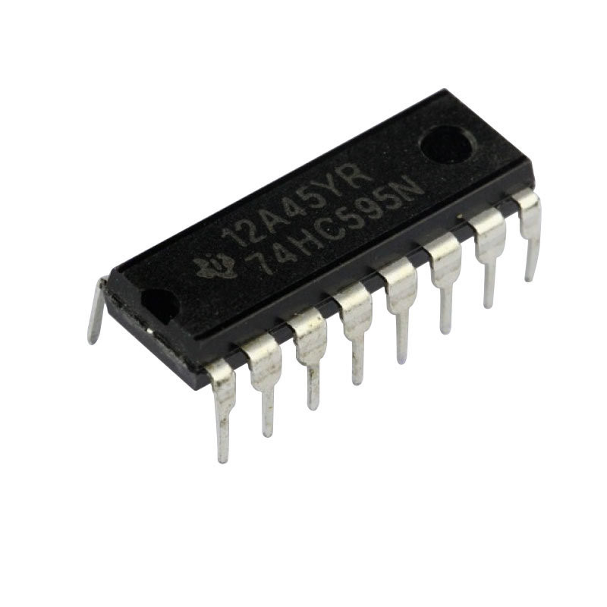
Servo Control
To control our servos we will use 74HC595N shift registers
This will give us 8 outputs per shift register
Inexpensive

Slide 28
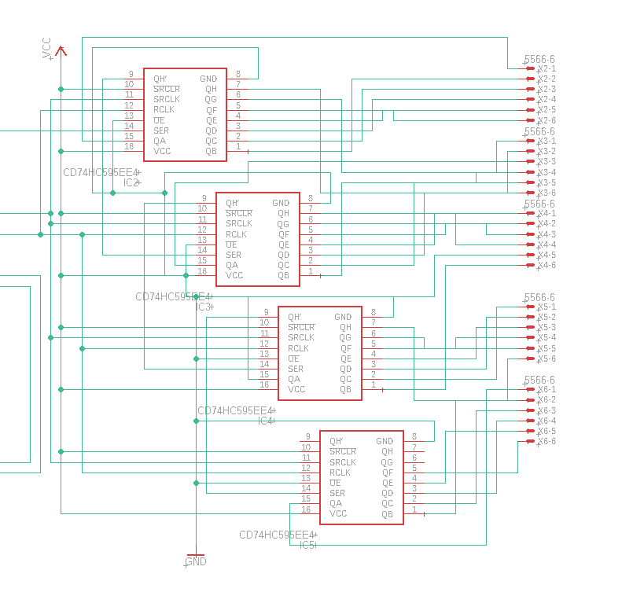
Servo Control
Shift Registers are daisy chained together
This saves pins on our microcontroller

Slide 29
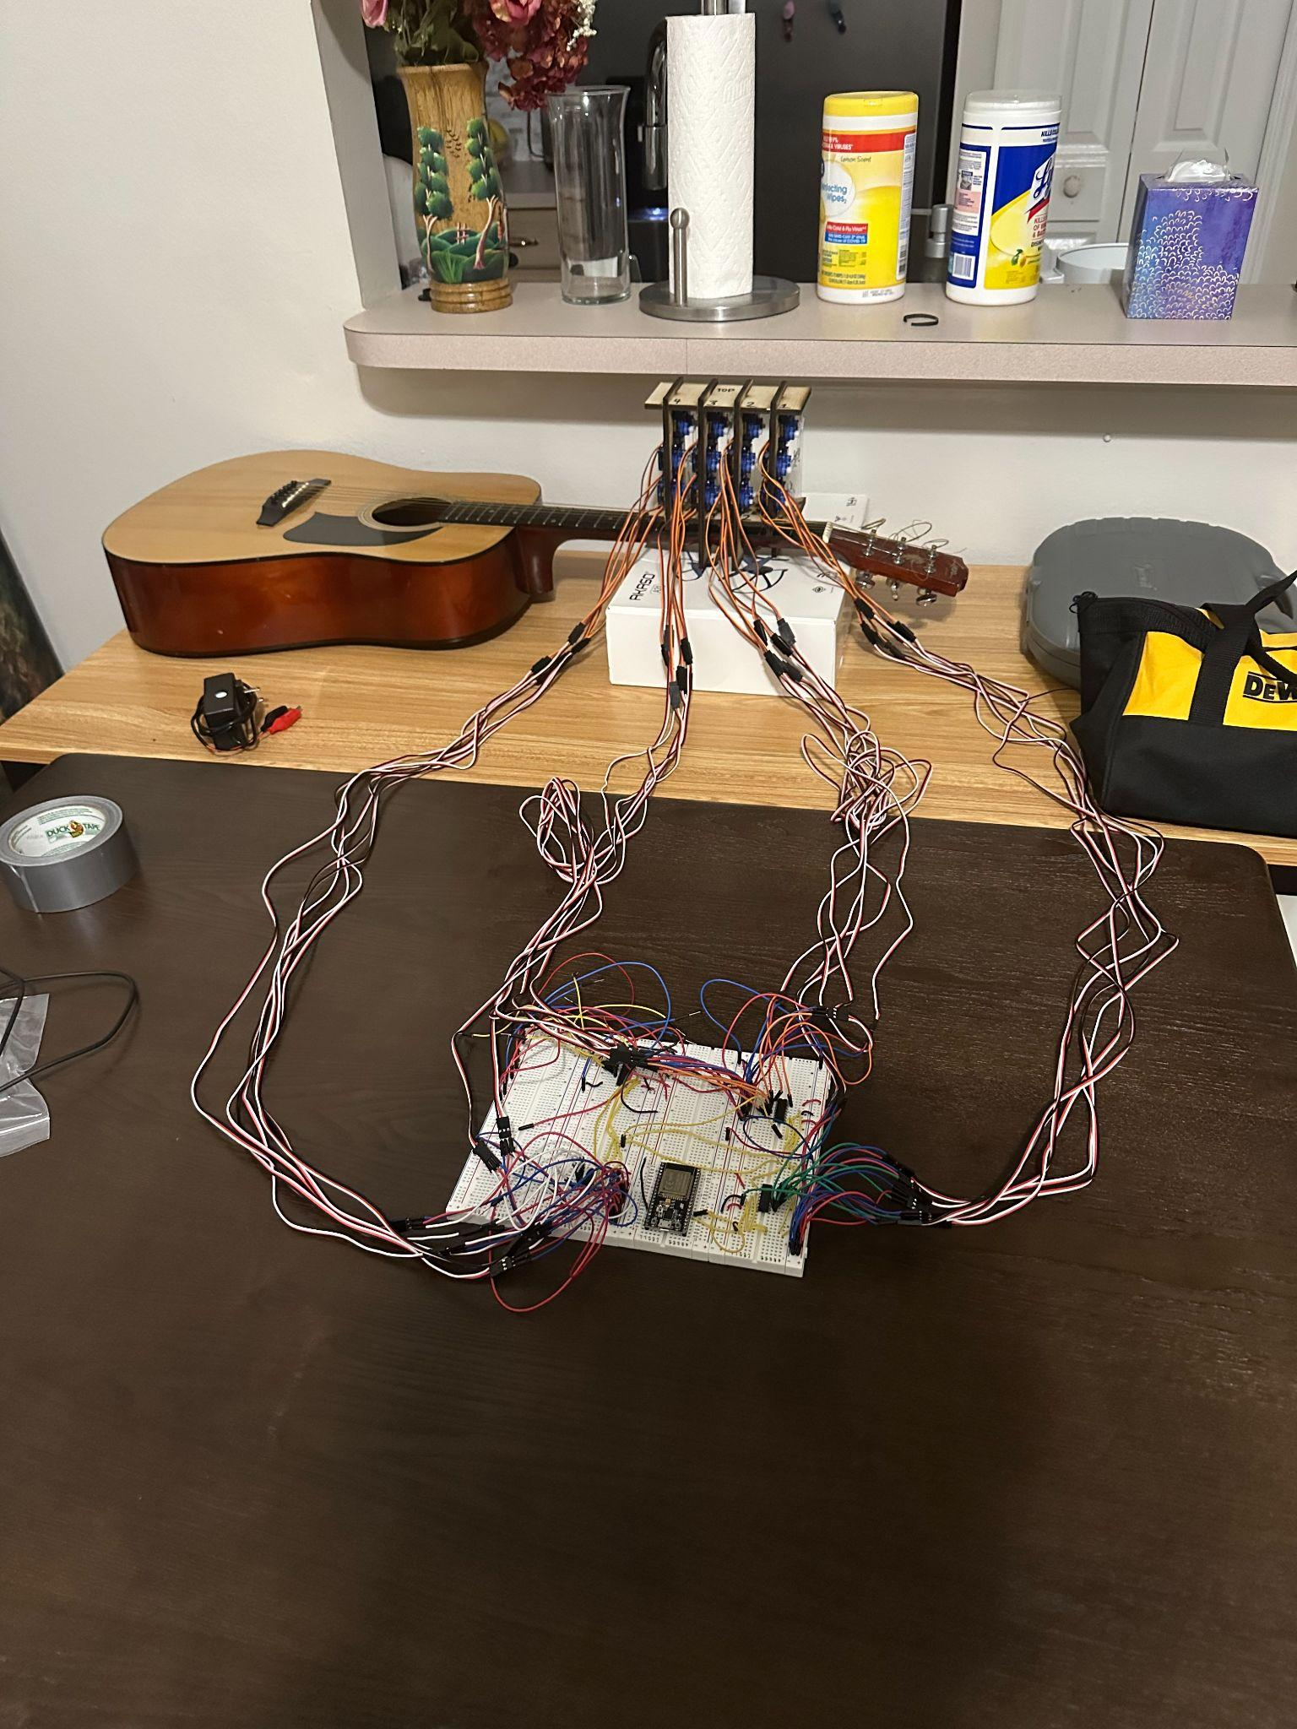
Detailed Design: Servo Control
Breadboard Prototype of Servo control complete
Needs to be tested with mount on guitar next

Slide 30
Detailed Design: Communication
We will be using BLE for our project
Bluetooth is not officially supported by micropython
Assumption that the user will be close to the guitar
Only needed for initial file transfer and starting a song

Slide 31
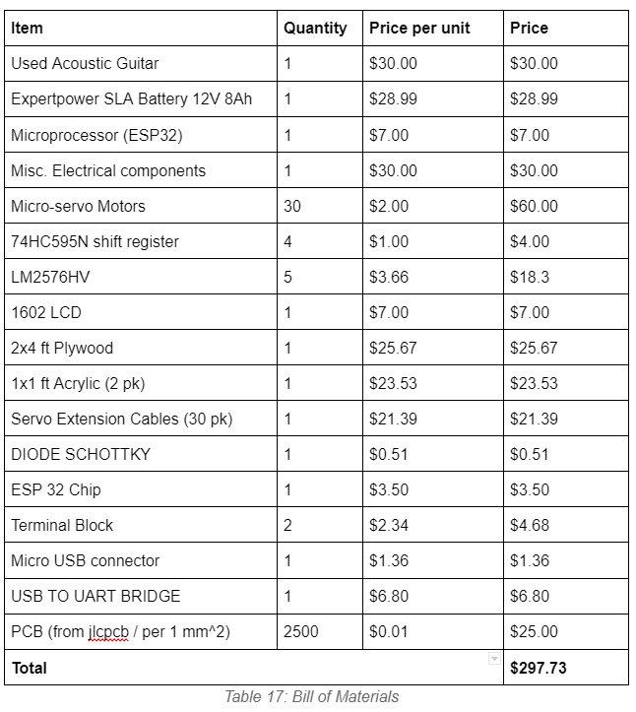

Budget / Finances
Thanks to our generous sponsors:

Slide 32
Current Progress (2/17)
MIDI Preprocessing Algorithm: 100%
Motor Output Algorithm: 90%
Fretting Mounts: 75%
Strumming Mount: 20%
Wiring: 75%
PCB Circuit Design: 80%
Regulator Implementation: 100%
Final Implementation: 60%

Slide 33
Stretch Goals
LCD Screen
LCD screen would be connected through I2C
LCD screen would display the title of the current song that is playing and a timer
Will be able to display other states as well
Fully acrylic mounts
More robust
Cleaner look and design
Expansion of note range (using more frets on guitar)
Would offer better sound quality

Slide 34
Questions?

